Slide 1
Lecture 9
Symmetric Block Encryption

Slide 2
Symmetric Block Encryption

Slide 3
Block cipher
the most commonly used symmetric encryption algorithms
input: fixed-size blocks, output: equal size blocks
provide secrecy and/or authentication services
Data Encryption Standard (DES), triple DES (3DES), and the Advanced Encryption Standard (AES)s

Slide 4
Feistel Cipher Structure

Slide 5
Feistel Cipher Structure
most symmetric block ciphers are based on a Feistel Cipher Structure
based on the two primitive cryptographic operations
substitution (S-box)
permutation (P-box)
provide confusion and diffusion of message

Slide 6
Feistel Cipher Structure
Horst Feistel devised the feistel cipher
based on concept of invertible product cipher
partitions input block into two halves
process through multiple rounds which
perform a substitution on left data half
based on round function of right half & subkey
then have permutation swapping halves
implements Shannon’s substitution-permutation network concept

Slide 7
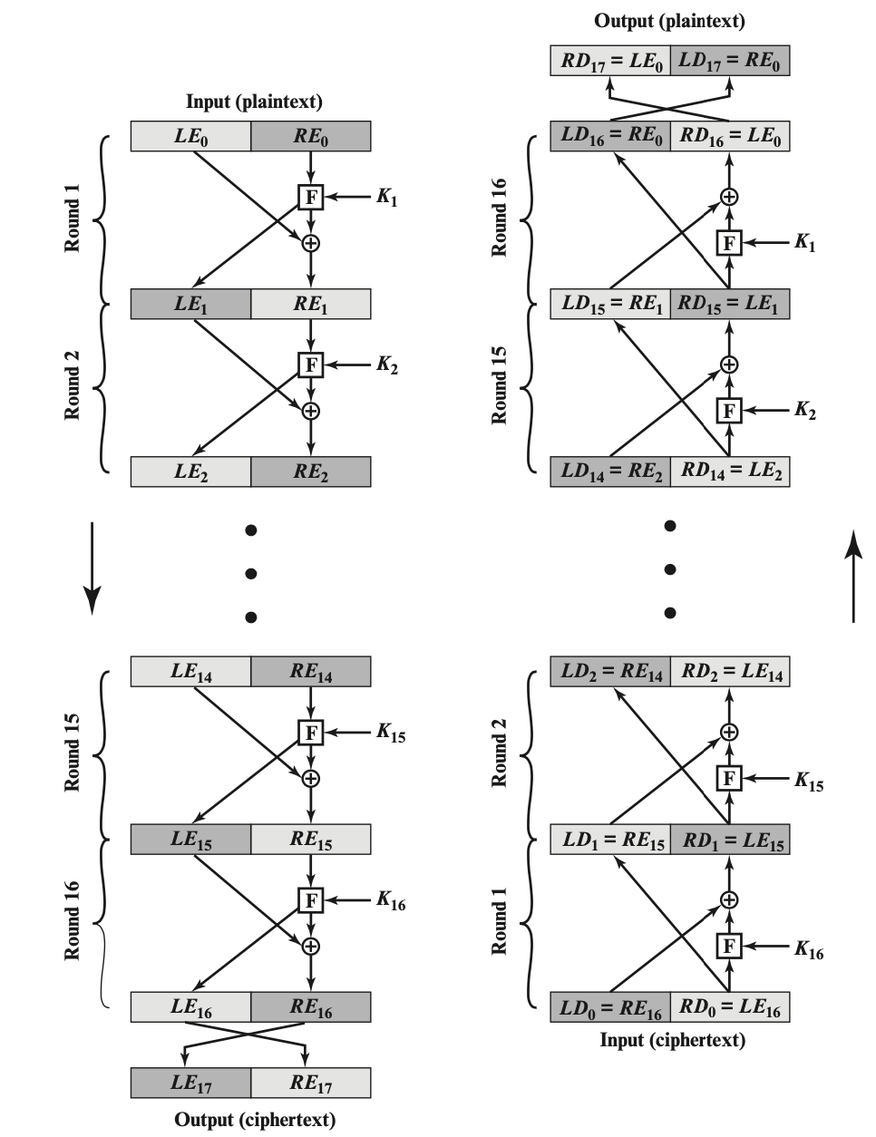
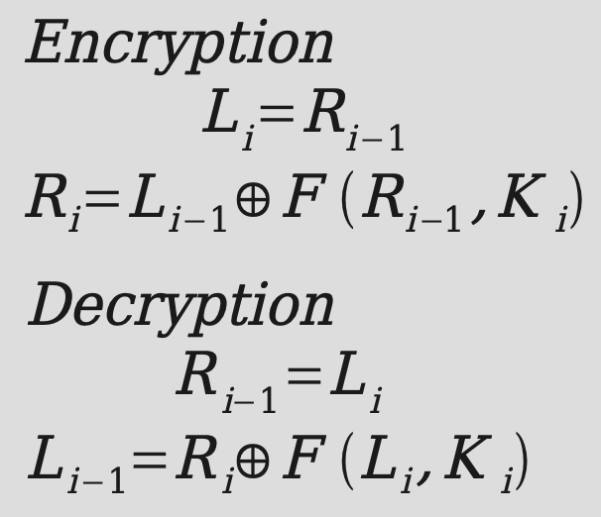
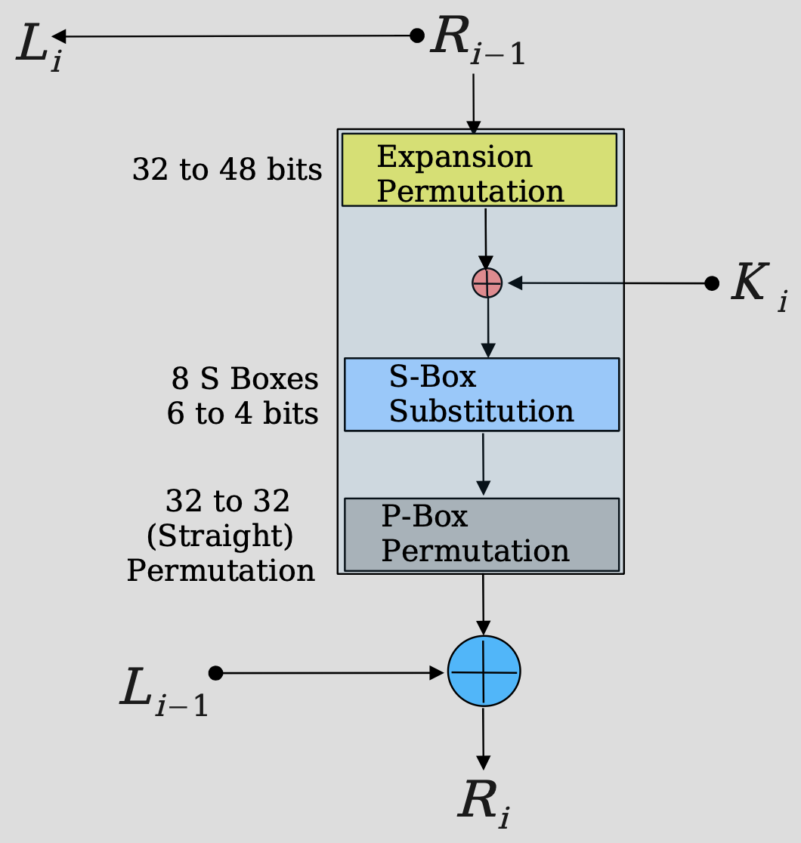
Feistel Encryption and Decryption

Slide 8
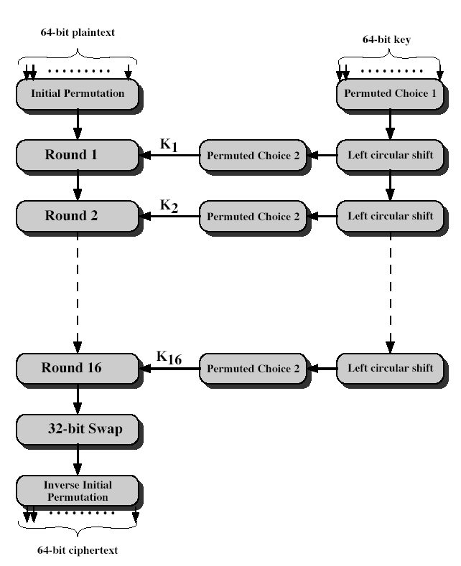
DES encryption
64 bits plaintext
56 bits effective key length

Slide 9
DES Weakness
short length key (56 bits) is not secure enough. Brutal force search takes short time.

Slide 10
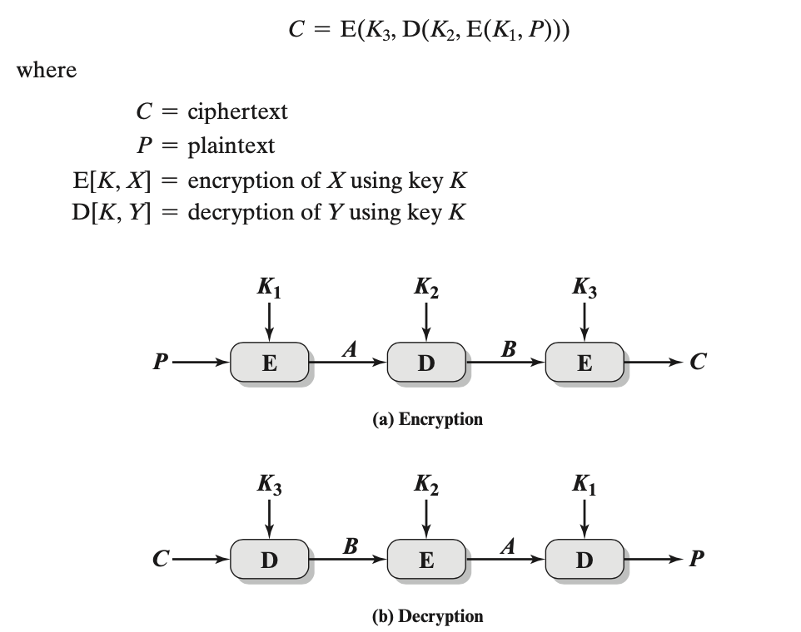
Triple DES (3DES)
Notes:
jumble-up, Decrypting with the wrong key will further convolute the output. 3DES is a feistel cipher structure, encryption and decryption are symmetrical

